Slide 1
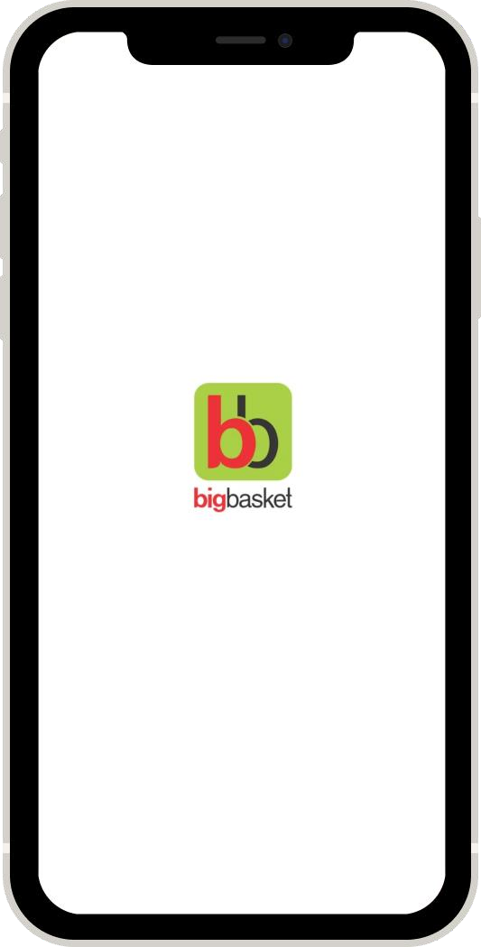
Big Basket:
Creating Power Users
Enhancing the product to create super loyal customers to the Grocery-Tech company
Subhadip Samanta
IIFT Delhi

Slide 2





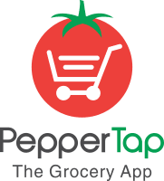



About Big Basket:
28
Cities
BigBasket is an online marketplace of grocery products. It allows users to purchase products across various categories including fruits, vegetables, staples, baked products, snacks, beverages, personal care products, baby care products, etc. of multiple brands.
Tata Group in advanced talks to buy 80% stake in BigBasket for $ 1.3 bn.
6 Mil
Customers
20000+
Products
Competitors
4.4
Rating
Problem statement:
Goal:
There is a lot of dissatisfaction among the
customers & there’s a lot of churn happening.
Create Power Users i.e super loyal customers to Big Basket thereby reducing the churn & increasing customer satisfaction.

Slide 3



User Personas
 | Naman, Newly Employed | Ankita, Working Mom | Suraj, Family Man
Demographics | 25 YO living in Bangalore, spends a lot on Food & Entertainment | 31 YO in Mumbai with a 4 yr old kid. Manages time b/w home and office | 33 YO living in Pune with his wife, kids and parents.
Big Basket usage | Ticket Size of 1000 and orders 4 times a month. Especially frozen food. | Ticket size of 2500₹ and orders 3/month. Especially on Cerelac & groceries. | Ticket size of 6000₹ twice a month for his whole family.
Motivations | Bit lazy to go to the Supermarket just beside his apartment. | One stop shop and insufficient time | Reduced prices with BB star membership
Pain Points | Unable to contact customer care as he wants to return an item. | Not available for delivery and hence the order is getting reprocessed again. | Quality of Fresh fruits and vegetables is his main concern.

Slide 4
What problems are they facing?
 |  |  |  |  |  | Reasons for dissatisfaction
Delivery Issues |  |  | Quality of Perishables |  |  | Customer Care |  |  | Customer Engagement |  |  | Miscellaneous
Often times the customer misses the phone call of the delivery person.
Perishables like fruits & veggies have very low shelf life and is variable for each order.
Any discrepancy in the order/ not availability of products etc leads to usage of customer care.
Traditional search and navigation is not as fulfilling as the traditional way of buying grocery.
Refund to wallet & not source bank
Change order within a given time before it gets processed.
Cause
Order gets reprocessed and customer has to wait for 24 more hours or refund for 7-9 days.
The customer not understanding the shelf life leads to inconsistent food experience.
The customer care process is very cumbersome and often very unresponsive.
Often customer spends a lot of time to find and navigate through his orders
Reduction in Customer Lifetime Value.
Increases churn
* Sampled from 50 Critical reviews
Effect
%
Reviews*
26%
23%
14%
14%
23%

Slide 5






Why & How do I solve the problems?
Goals
Solutions
Increase Customer Satisfaction
Delivery executive drops off the order in the nearest kiosk or Trent Hypermarket
BB tracks the life of perishables based on it’s picture and suggests to the user.
The customer can voice order his whole list of groceries making it easier for them.
Increase Customer Life Time Value
BB Click & Collect
BB Shelf life Tracker
Voice Ordering
Customer Care can be channelized through the Chat Bots with the huge # of complaints.
Like our nearby kiranawala, BB
allows it’s star users
to buy now and pay later.
Just not the direct search and voice ordering. Searching based on recipes and ingredients.
Reduce Churn Rate
BB Chatbot
BB Khata
BB Recipe Search
Increase Referrals

Slide 6
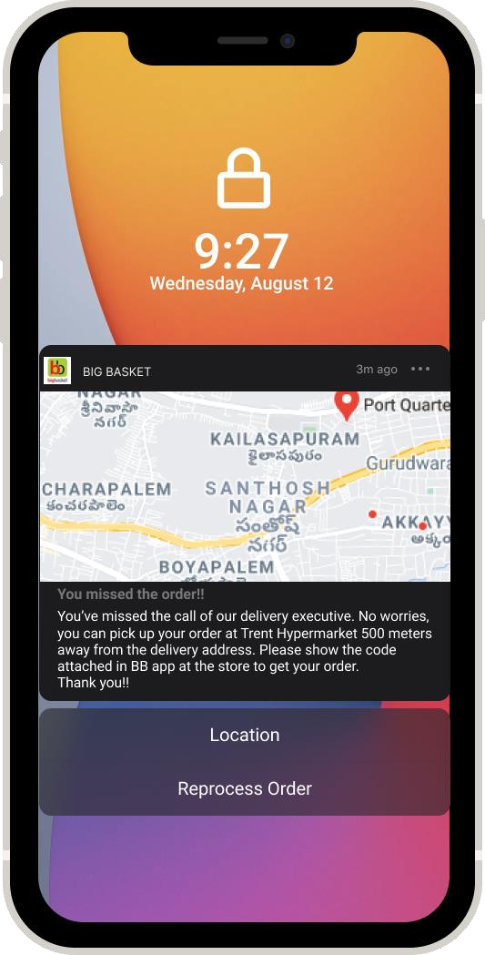
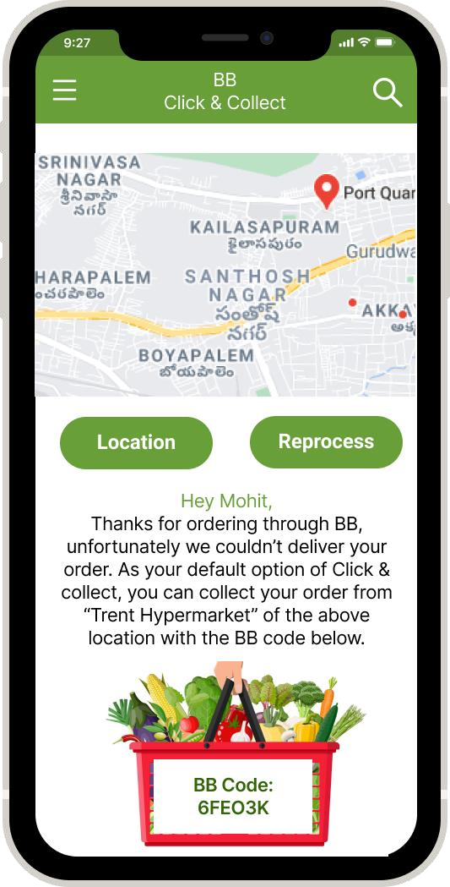
Feature 1: BB Click & Collect
Work Flow:
Home Delivery
Didn’t lift Delivery exec’s call
Delivery
exec drops off at →
Location of the kiosk/ Supermarket
Order
Direct click & Collect Delivery exec drops off at →
Dropping off
Points
Dropping off Points:
1. Super Market: With the latest acquisition by Tata, we can leverage it’s 36 Trent Hyper & Supermarkets for starters.
BB code for authentication purposes
2. Kiosks: BB has a great network of kiosks under BB instant. Using them as storage for a customer nearby.
Metrics:
Current process of unattended delivery
% Unattended Deliveries:
# 𝑜𝑓 𝑅𝑒𝑝𝑟𝑜𝑐𝑒𝑠𝑠𝑒𝑑 𝑂𝑟𝑑𝑒𝑟𝑠
CC to RP Ratio:
# 𝑜𝑓 𝐶𝑜𝑙𝑙𝑒𝑐𝑡𝑒𝑑 𝑜𝑟𝑑𝑒𝑟𝑠
# 𝑜𝑓 𝑅𝑒𝑝𝑟𝑜𝑐𝑒𝑠𝑠𝑒𝑑 𝑂𝑟𝑑𝑒𝑟𝑠
# 𝑜𝑓 𝑂𝑟𝑑𝑒𝑟𝑠
1. Notification
2. Application

Slide 7
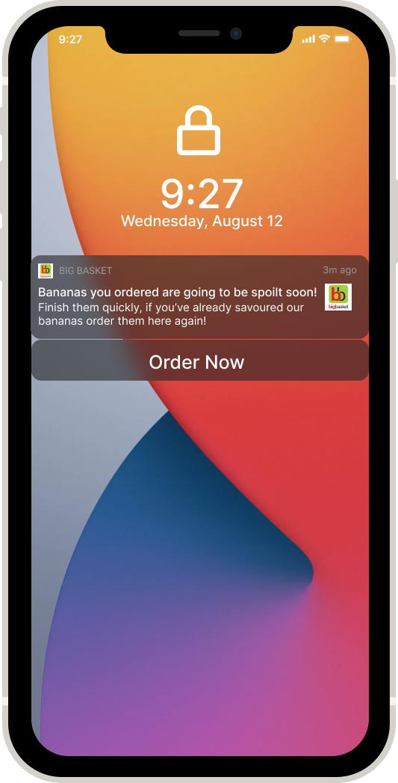
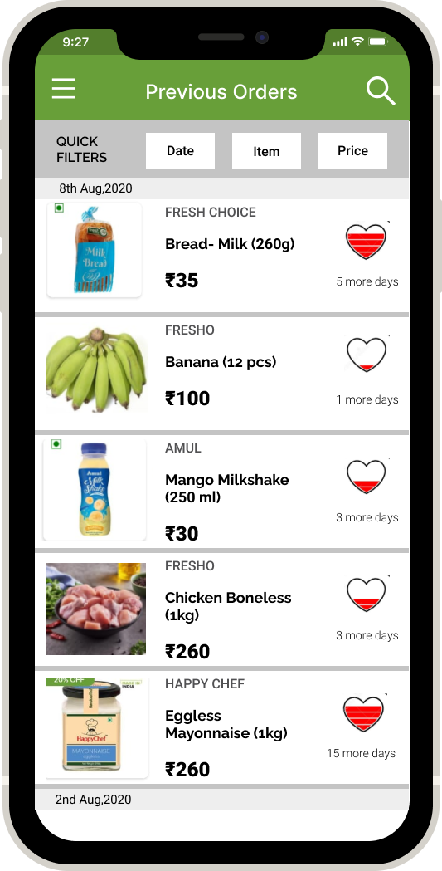
Feature 2: BB Shelf Life Tracker
BB Shelf life tracker helps us to track the life of
perishables and notifies us when they’re about to be
spoilt.
Process:
Huge data
set of fruits
Perishables
Fruits photo
scanned in warehouse
Notification about the perishable near to being spoilt
Computer Vision- Life tracking
Order Placed
Nudging the customer to order more
Non Perishables
Bar code
scanned
Know it’s
expiry date
Science & Tech Behind it:
Fruit freshness grading via computer vision technology exploits on the fruit texture, colour, shape, wholeness, spots, bruises, and blemishes for visual feature evaluation and can reflect the speed of fruit deterioration.
Check out this research paper for more info
In App: Life tracking of all the orders, in the shape of a heart battery.
Metrics:
Click-through Rate: Average Time to Reorder
# 𝑜𝑓 𝑐𝑙𝑖𝑐𝑘𝑠 𝑜𝑛 "𝑂𝑟𝑑𝑒𝑟 𝑁𝑜𝑤"
# 𝑜𝑓 𝑁𝑜𝑡𝑖𝑓𝑖𝑐𝑎𝑡𝑖𝑜𝑛𝑠
Frequency of Reorders/mo

Slide 8
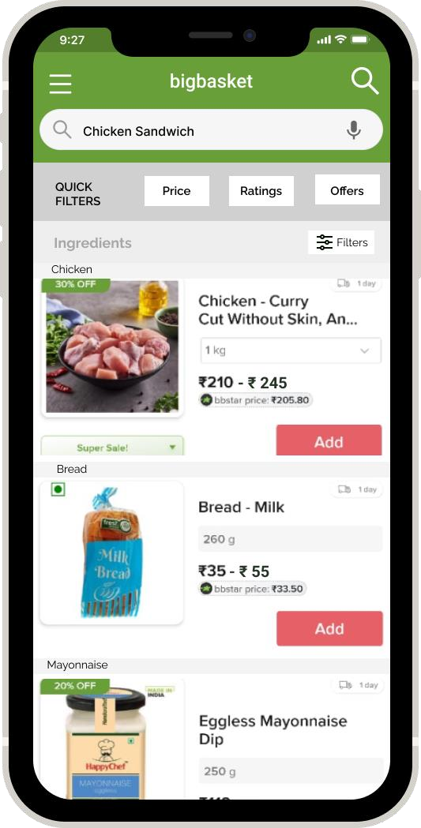
Feature 3: Innovative Ordering
a) BB Recipe Ordering:
The Job to be done is cooking a recipe, hence it make logical sense to
allow recipe based search.
For making this technologically possible, we need to create a directory of recipes, which can be directly scraped from many cookbooks in internet and using NLP we can create a dictionary of ingredients for every recipe.
Recipe Based search
& Voice Ordering
Shows us the results available based on price, or ratings or the best combo available which we can benchmark with the actual “Chicken Sandwich”
Use Case: We can nudge people to order more especially during festives, events ; for example: “ Make yourself Sabudhana Kichidi this Navaratri, order the ingredients from here”
b) BB Voice Ordering:
We can delete few items or change the quantity if we wish to.
Voice Order helps to place order directly, which can basically eliminate the tedious search process, decrease the time to place an order, and save the user's time.
Price Ranges shown for each ingredient and allows us to select our favourite brand
This can help in increase the adoption of Big basket among Baby Boomers & Gen X
Technologically the speech software breaks down the audio of a speech recording into individual sounds, analyzes each sound, using algorithms and find the most probable word which fits in that language, and transcribes those sounds into text.

Slide 9
Other Explorable Solutions:
BB Khata
How BB Khata can revolutionize the Grocery industry?
Khata basically means an account held with a merchant, in general connotation when you have a debit and credit relation with the merchant.
Indian kirana’s mainly run on trust hence they allow “Buy Now Pay Later” (BNPL) with regular customers.
So BB Khata is a microcredit facility mainly available to few creditworthy customers (or simply BB star) where you can buy now and pay later maybe at the end of the month.
This Post paid grocery purchases mainly appeal to the millennials and Gen-Z who relatively extend their expenditures.
BB Chatbot
Current Problem:
No(queries) >>>> No(Queries Handling Capacity). Hence
there’s a time lag
40% of the queries are related to availability of certain groceries/ increased price after ordering.
45% of the queries are related to delivery issues and
refund of money into the BB wallet rather the source bank.
10% of the queries are related to BB star membership
How BB chatbot solves the problem?
Simply classifies all the queries into different buckets and issues tickets.
Solves few problems like Star Membership & refunds directly from the chat.
Better data storage and analytics can done to investigate and make the processes faster.
* Sampled from 30 Critical reviews about customer care
Metrics Used:
Number of Khatas, Credit to total consumption, Average Payback Time
Metrics Used:
Number of Queries resolved, Average time taken to resolve a query

Slide 10
Fin.

Slide 11
